Slide 1

Predictive policing
Presented By :
2010030481 – Manne Tejaswini
2010030521 – Konyala Eshika Sanjana
2010030523 – Abhiram Sharma
2010030532 – Komaravelli Sai kamal

Slide 2
TABLE OF CONTENTS
01
02
03
04
Project area
Literature Survey
Problem Statement
Conclusion

Slide 3

Project Area:
predictive analytics
A predictive analytics technology makes predictions about the future based on certain unknowns. Artificial intelligence (AI), data mining, machine learning, modeling, and statistics are used to make these determinations.
An example of data mining is the process of analyzing large sets of data to discover patterns. The same is true for text analysis, except for large blocks of text.
The use of predictive models is widespread, including:
Forecasts for the weather
Video game creation
Voice-to-text translation for mobile phones
The customer service department
Development of an investment portfolio
In all of these applications, descriptive statistical models are used to predict future data using existing data.

Slide 4
Test
Literature Survey

Slide 5
S. | TITLE | Authors | Date | Publisher | Techniques | Datasets | Pros
1 | A Clustering Based Hotspot Identification Approach For Crime Prediction | Hajela, Gaurav, Meenu Chawla, and Akhtar Rasool | 16 April 2020 | Maulana Azad National Institute of technology, Bhopal 462023, India | 2-Dimensional Hotspot analysis, point mapping, State of art techniques | datasets of San Francisco city, | It is proposed to identify hotspots for single and multiple categories of crime. It is shown in the paper that hotspot analysis can improve crime prediction accuracy as compared to model that only uses state of the art techniques
2. | Predictive Policing and Crime Control in The United States of America and Europe: Trends in a Decade of Research and the Future of Predictive Policing | Mugari, Ishmael, and Emeka E. Obioha. | 20 June 2021 | Department of Social Sciences, Walter Sisulu University | information technology, data, and analytical techniques, machine learning and refined algorithms, RTMDx | United States of America | Their discussion focused on better algorithms that could be used for predictive policing
3 | To predict and to manage. Predictive policing in the United States | Bilel Benbouzid, Universite Paris-Est Marne-la-Vallee, Marne la Vallee 77454, France | January 1, 2019 | Creative Commons Non Commercial CC BY-NC | developers conceived techniques , machine learning techniques | United States of America | Finally, the article describes how developers seek ways to audit training datasets and to calculate an appropriate amount of stop and frisk over the population.

Slide 6
S.NO | TITLE | Authors | Date | Publisher | Techniques | Datasets | Pros
4 | The effect of differential victim crime reporting on predictive policing systems. | Nil-Jana Akpinar, Maria De-Arteaga, Alexandra Chouldechova. | 4 Feb 2021 | Data Science & Machine Learning Department Carnegie Mellon University | PredPol, SEPP models, Expectation–maximization algorithm, hot spot prediction algorithm | crimes in india | Their discussion focused on better algorithms that could be used for predictive policing
5. | Crime hotspot prediction based on dynamic spatial analysis. | Gaurav Hajela, Meenu Chawla, Akhtar Rasool. | 13 November 2021 | Maulana Azad NationalInstitute of Technology, Bhopal, India | SPBM,DSBM,HBM CSM. | Chicago crime data, Census data, Chicago taxi trip data | predicts crime events in spatial units and classifies each of them into a hotspot category based on the number of crime events.

Slide 7
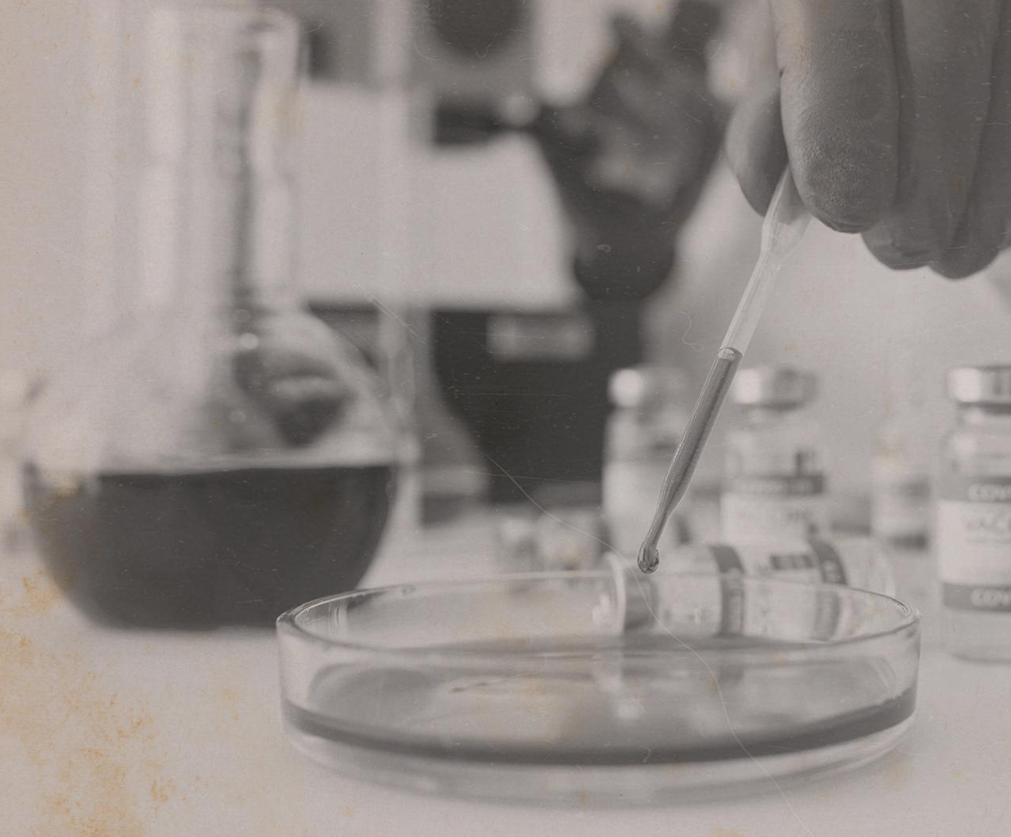
Problem Statement
CRIME
It is quite obvious that the rate of crimes is increasing day by day in all societies in the world.
A lot of important measures, on the one hand, are being taken by the governments in order to reduce or even eradicate different types of crimes, yet there is no significant difference in the crime rate.
So one of the ways of preventing crimes from happening is predicting the occurrence of crime known as predictive policing.
Based on multiple Datasets obtained from data. The world we’ll analyze and try to predict the place of occurrence of crime.

Slide 8
conclusion
By going through these various research papers, we got to know a lot about different techniques and dataset's used by some of the best researchers around the world
Therefore, we want to explore the topic further and add more features to our project, so that we can achieve the best result with the best-trained model at the end.
HOMICIDE

